Slide 1
SQL Lesson 14a
Basic Subqueries
V1.0 2020

Slide 2
Lesson Objectives
After completing this lesson you will be able to
Describe the types of problems that subqueries can solve
Write subqueries in the WHERE clause
Create single-row and multi-row subqueries
Use subqueries in the HAVING clause

Slide 3
Subqueries
Introduction to subqueries
Subqueries in the where clause
Single row subqueries
Multi row subqueries
Subqueries in the having clause

Slide 4
Introduction to subqueries
Often, you have two or more questions in mind that need to be answered sequentially
Subqueries allow you to solve these types of problems
Although subqueries can be placed inside almost any clause, they are commonly found in the WHERE clause
Subqueries can also be found in the HAVING clause
In Lesson 19a Advanced Subqueries, subqueries in the FROM clause will be examined

Slide 5
Introduction to subqueries
Who earns a higher salary than employee Russell?
- To solve this problem, you need two queries
- One to find out how much Russell earns, and
- Another to find out who earns more than that amount
Main Query
 | Which employees earn more than the salary selected below?
 | Subquery:
 |  | What is Russell’s salary?

Slide 6
Subqueries
Introduction to subqueries
Subqueries in the where clause
Single row subqueries
Multi row subqueries
Subqueries in the having clause

Slide 7
Subqueries in the where clause
The inner query, or subquery executes before the main query.
The result of the subquery is used to complete the outer query.
The shorthand shows the basic layout of subqueries in the WHERE
SELECT select_list
FROM table
WHERE column_name operator (SELECT select_list
FROM table
WHERE …);
Enclose subqueries in parentheses
Place subqueries on the right of the comparison operator for readability

Slide 8
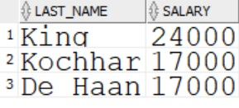
Subqueries in the where clause
The inner query returns the salary of employee Russell
The main query returns those who earn more than 14000
SELECT last_name, salary
FROM employees 14000
WHERE salary > (SELECT salary
FROM employees
WHERE employee_id = 145);

Slide 9


Types of subqueries
Single row subquery
MAIN Query
 | Subquery
returns
Multi row subquery
MAIN Query
 | Subquery
returns
…

Slide 10
Subqueries
Introduction to subqueries
Subqueries in the where clause
Single row subqueries
Multi row subqueries
Subqueries in the having clause

Slide 11
Single row subqueries
Return only one row
Use single-value comparison operators in the WHERE clause of the outer query
Operator | Meaning
= | Equal to
!= or <> or ^= | Not equal to
< | Less than
<= | Less than or equal to
> | Greater than
>= | Greater than or equal to

Slide 12
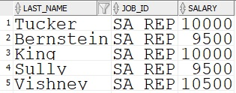
Single row subqueries
Each subquery returns one row of data
SELECT last_name, job_id, salary
FROM employees SA_REP
WHERE job_id = (SELECT job_id
FROM employees
WHERE employee_id = 152)
AND salary > (SELECT salary 9000
FROM employees
WHERE employee_id = 152);

Slide 13

Single row subqueries
Group functions are not allowed in the WHERE clause as discussed in Lesson 10a Aggregating Data Using Group Functions
However, they can be used in subqueries in the WHERE clause
SELECT last_name, job_id, salary, manager_id FROM employees 2100
WHERE salary = (SELECT MIN(salary)
FROM employees;

Slide 14
Subqueries
Introduction to subqueries
Subqueries in the where clause
Single row subqueries
Multi row subqueries
Subqueries in the having clause

Slide 15
Multi row subqueries
Return more than one row
Use multi-value comparison operators in the WHERE clause of the outer query
Operator | Meaning
IN | Equal to any member in a list or returned in a subquery.
ANY | Must be preceded by =, !=, >, >=, <, <=. Compares to each value in a list or returned by a subquery.
ALL | Must be preceded by =, !=, >, >=, <, <=. Compares to all values in a list or returned by a subquery.

Slide 16
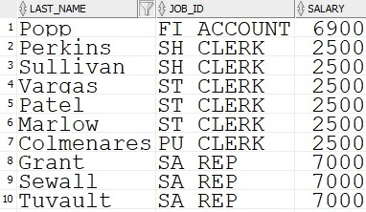
Multi row subqueries using the IN operator
SELECT last_name, job_id, salary
FROM employees
WHERE salary IN (SELECT MIN(salary) 2500 6900 7000…
FROM employees
GROUP BY department_id);
…

Slide 17
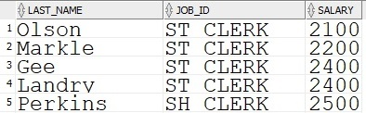

Multi row subqueries using the ANY operator
SELECT last_name, job_id, salary
FROM employees
WHERE salary < ANY (SELECT salary 4200 4800 6000 9000 FROM employees
WHERE job_id = ‘IT_PROG’)
AND job_id != ‘IT_PROG’;
…

Slide 18
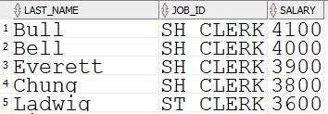

Multi row subqueries using the ALL operator
SELECT last_name, job_id, salary
FROM employees
WHERE salary < ALL (SELECT salary 4200 4800 6000 9000 FROM employees
WHERE job_id = ‘IT_PROG’);
…

Slide 19
Subqueries
Introduction to subqueries
Subqueries in the where clause
Single row subqueries
Multi row subqueries
Subqueries in the having clause

Slide 20
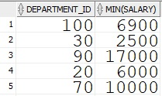
Subqueries in the having clause
The subquery is executed first
The optimizer returns the result into the HAVING clause of the main query
SELECT department_id, MIN(salary)
FROM employees
GROUP BY department_id 2100
HAVING MIN(salary) > (SELECT MIN(salary) FROM employees);
…

Slide 21
Quiz
True or false?
Subqueries execute after the main query executes
Subqueries are useful when you have more than one question to answer
Subqueries are useful when hard coding of literal values is not practical
Subqueries can be placed in almost any clause
Subqueries can return one or more rows of data

Slide 22
Review
In this lesson you learned how to
Describe the types of problems that subqueries can solve
Write subqueries in the WHERE clause
Create single-row and multi-row subqueries
Use subqueries in the HAVING clause

Slide 23
Questions?

